Slide 1



2026
Importance of Probability in Machine Learning
Machine Learning isn't about "perfect" logic; it’s about calculating the most likely outcome.

Slide 2
2026
Why Do We Need Probability?
Real-world data is messy, incomplete, and noisy. Probability allows models to say "I don't know for sure, but I’m 85% certain."
Key Concepts:
Inherent Randomness: Some systems are naturally unpredictable.
Incomplete Observability: We rarely have all the facts (e.g., predicting a medical diagnosis without every possible test).

Slide 3
2026
The Pillars (Frequentist vs. Bayesian)
Frequentist View: Probability based on how often an event occurs in many trials (e.g., flipping a coin 1,000 times).
P(B|A) P(A)
P(A|B) =
Bayesian View: Probability as a "degree of belief" that updates as we see new evidence.
P(B)

Slide 4
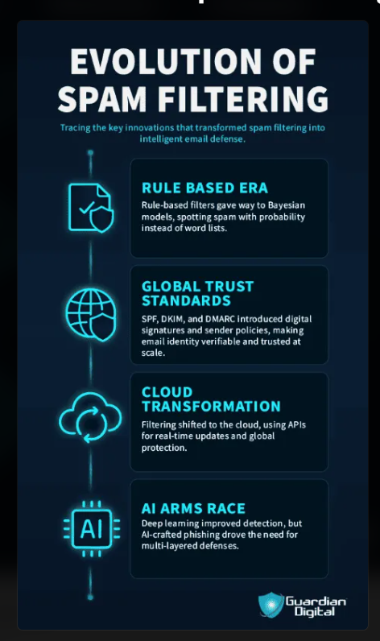
2026
Probability in Key Algorithms
Classification: Algorithms like Logistic Regression don’t just give a "Yes" or "No"—they give a probability score between 0 and 1.
Generative Models: Tools like ChatGPT or Midjourney use probability distributions to predict the "next most likely" word or pixel.
Generative Models: Tools like ChatGPT or Midjourney use probability distributions to predict the "next most likely" word or pixel.

Slide 5
2026
Measuring Success & Fixing Errors
Likelihood: Measuring the "Goodness of Fit"
Think of this as a reality check. If our model predicts a 90% chance of rain and it actually rains, the "likelihood" is high.
Cross-Entropy: The "Penalty" for Being Wrong
This measures the gap between what the model predicted and what actually happened.
If the model is very confident but totally wrong, the "Cross-Entropy" score goes up. It’s like a penalty points system the goal is to keep this number as low as possible.
Optimization: Tuning the Machine
We don't just leave the errors as they are. We use calculus to find exactly where the model messed up.
By "tuning" the internal settings, the model learns from its mistakes and moves its next prediction closer to the truth.

Slide 6
2026
Why This Actually Matters
Without probability, Machine Learning would just be a rigid set of "If-Then" rules. It wouldn't be able to handle the messy, unpredictable nature of the real world.
As AI becomes part of our daily lives—like in self-driving cars—it’s not enough for a model to just give an answer. It needs to know when it’s "confused."
Quantifying uncertainty is what keeps AI safe; it’s the difference between a car guessing a stop sign and "knowing" it’s there.
Probability is the logic of science. so basically If you want a machine to think like a human, you have to teach it how to deal with doubt.

Slide 7


2025
Thank You!

